Slide 1



2026- IEEE International Conference on Intelligent Systems, Smart and Green Technologies (ICISSGT – 2026) Conference Record: #67741
Title:-A Machine Learning Framework for Forest Fire Prediction in the Nallamala Forest Using NDVI and Synthetic Weather Data
Presenter:-Gairuboina Naveen Kumar
Copy Right IEEE

Slide 2
OUTLINE
Abstract
Introduction & Motivation
Problem Statement & Research Gap
Objectives
Methodology
System Architecture
Results and Analysis
Conclusion
Future Scope
Question and Answers

Slide 3
ABSTRACT
Early forest fire prediction for the Nallamala Forest, India
Uses MODIS NDVI and synthetic weather data (2012–2025)
SMOTE and feature engineering handle fire data imbalance
XGBoost–LightGBM ensemble used for prediction
Supports early warning and proactive fire management

Slide 4
INTRODUCTION & MOTIVATION
Forests regulate climate and support biodiversity
Nallamala Forest is highly fire-prone
Rising fire incidents threaten ecosystems
Terrain limits rapid monitoring and response
Existing systems detect fires too late
Predictive ML models enable early warnings

Slide 5
PROBLEM STATEMENT & RESEARCH GAPS
PROBLEM STATEMENT:-
Existing systems are largely reactive and lack reliable early prediction of forest fires in the Nallamala region.
RESEARCH GAPS:-
Lack of region-specific predictive models for Nallamala
Underuse of NDVI vegetation indices for fire risk prediction
Current fire monitoring systems detect fires after ignition rather than before.

Slide 6
OBJECTIVES
Build an early warning system for forest fires
Use NDVI and weather data to assess fire risk
Address data imbalance in fire events
Improve detection accuracy using ensemble models
Aid proactive forest fire management

Slide 7
METHODOLOGY
Data Sources: MODIS NDVI (250 m), NASA POWER (Temperature, Humidity, Radiation)
Time Span: 2012–2025
Preprocessing: Missing value handling, lag feature extraction, normalization
Class Balancing: SMOTE to address rare fire events
Modeling: Ensemble of LightGBM and XGBoost (soft voting)
Evaluation: Accuracy, Precision, Recall, F1-score, ROC-AUC, Confusion Matrix

Slide 8
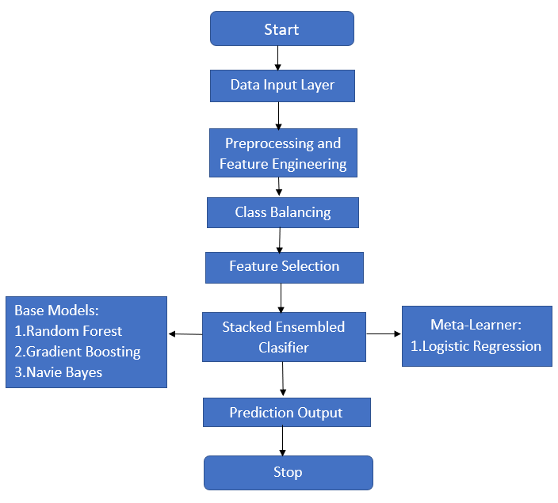
SYSTEM ARCHITECTURE
Input Layer: NDVI vegetation indices and weather variables
Preprocessing: Data cleaning, normalization, lag feature creation
Class Balancing: SMOTE to handle rare fire events
Feature Selection: Selection of influential fire-related features
Ensemble Learning: Stacked model with Random Forest, Gradient Boosting, and Naive Bayes
Meta-Learner: Logistic Regression for final decision
Output: Fire / Non-Fire prediction

Slide 9
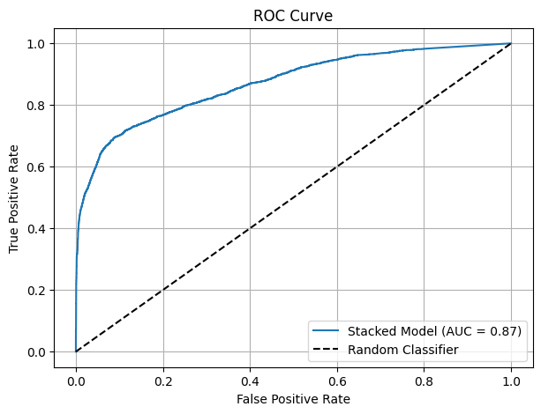
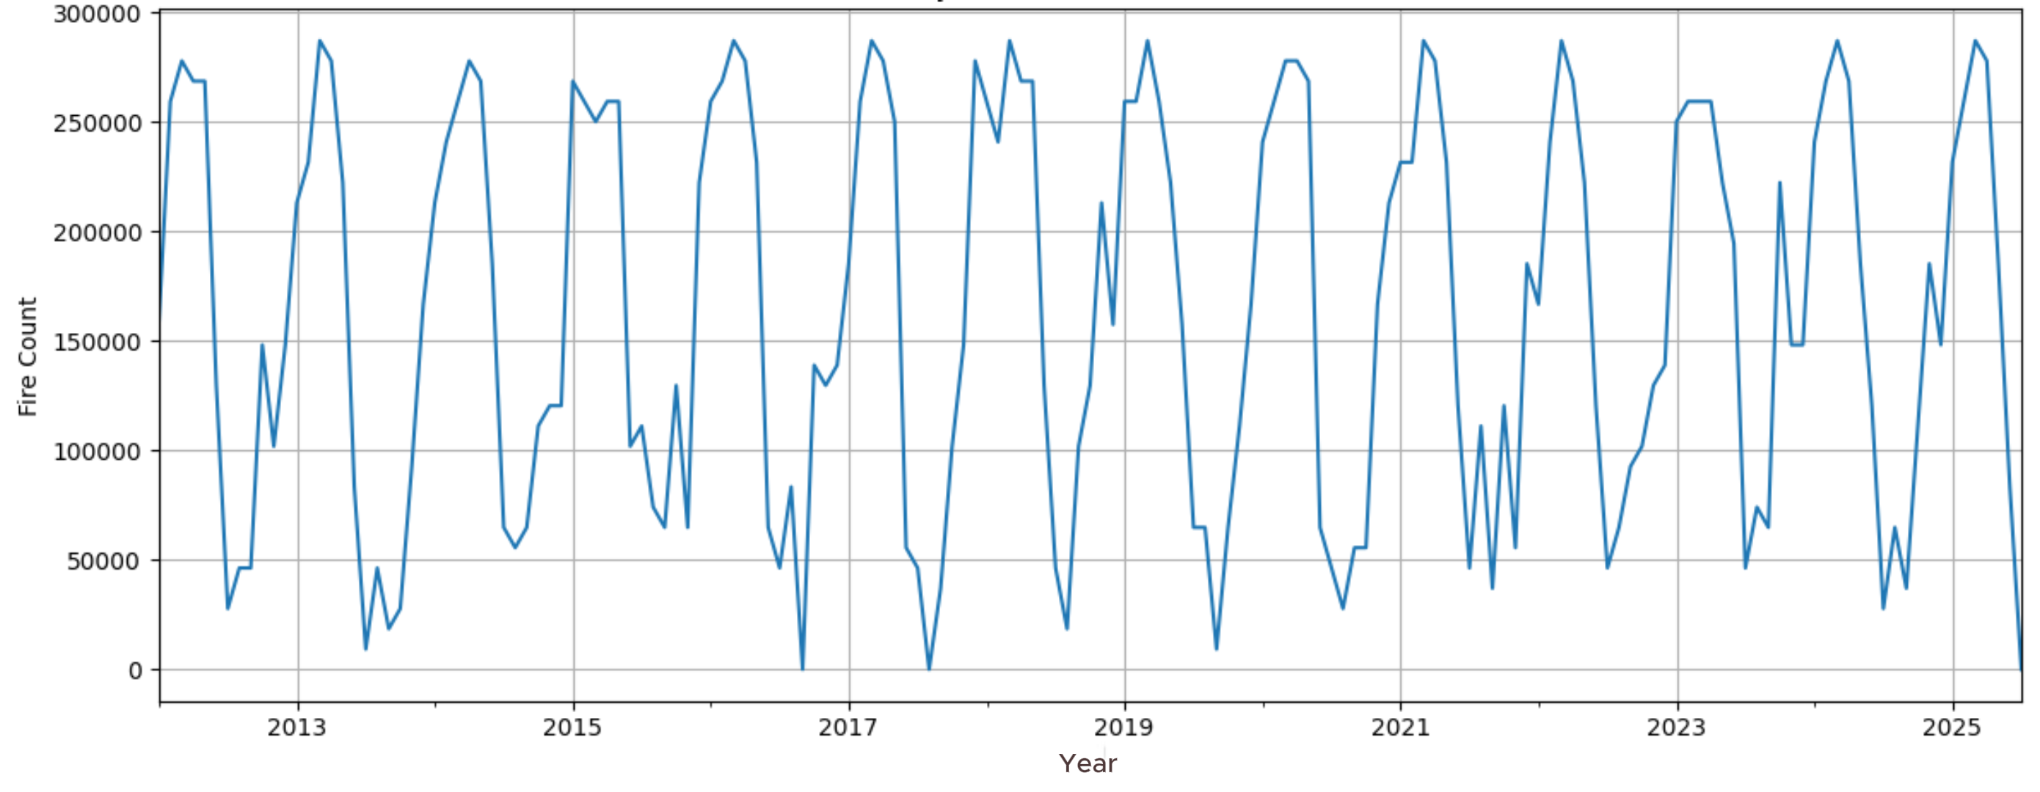
RESULTS AND ANALYSIS
ROC–AUC of 0.87 demonstrates strong and reliable discrimination between fire and non-fire events, supporting effective early fire detection.
Fire occurrences from 2013–2025 show consistent dry-season peaks and monsoon declines, highlighting strong climatic influence on wildfire activity.

Slide 10
CONCLUSION
Proposed NallaFireNet for fire prediction
Combined NDVI and climate data
Ensemble model shows strong fire recall
Vegetation and weather are key drivers
Supports early fire warning systems

Slide 11
FUTURE SCOPE
Use real-time data feeds
Apply to other Indian regions
Add soil and terrain features
Explore LSTM / Transformer models
Improve precision–recall balance

Slide 12

THANK YOU
ANY
QUESTI NS

